Slide 1
Single Page
Applications
martin.beeby@Microsoft.com - @thebeebs
Notes:
Good Morning it’s Tuesday the 9th of December and today were are going to be looking at Building Web front ends using the latest web standards

Slide 2
Modern web standards
JavaScript library overview
DEMO Ember.JS
Notes:
Today I’m going to cover three areas, firstly we’re going to talk a little bit about web standards that allows us to build the modern web. Then I’ll cover a few key JavaScript frameworks and finally we will dive a little depper into a Ember.js Demo >>
I hope your getting the full beauty of that Origami bird transition on the screen cast.

Slide 3
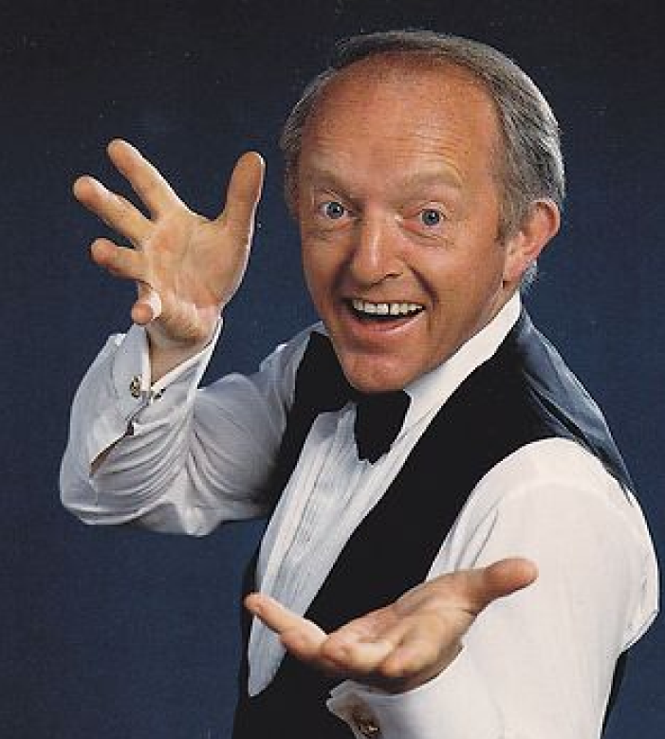
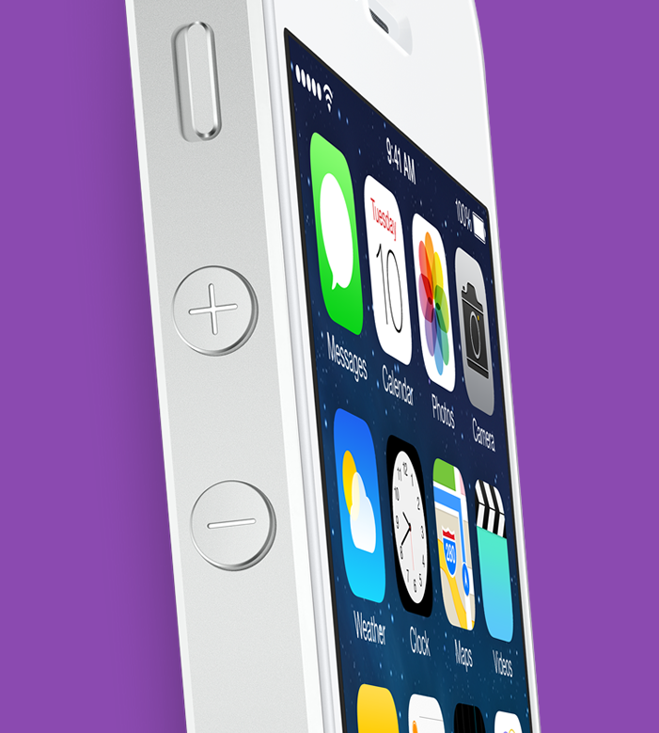


extremely high expectations
Apps are winning
They are satisfying need
The Web can be magical
Notes:
Consumers have really high expectations of software these days. If a website doesn’t load in a few seconds they go elsewhere. If a site doesn't work first time, they go else where. In many instances apps are providing a better experience than website. >>
They are satisfying a need. Delivering beautiful experiences, with touch interfaces that support gestures, that work offline, that work on mobile devices. If you you place that next to an web app that’s been written maybe as year ago. Often the App wins. >>
But the web can be magical >>

Slide 4
HTML5 + CSS3 = Magic!
Notes:
The combination of web standards such as HTML5 and CSS3 can result in beautiful, solid, easy to maintain websites that can rival apps. The challenge is that as a web developer it’s all to easy to keep doing things the way I’ve always done them. But if you do take advantage of new capabilities in browsers then we can deliver sites that can meet our users high expectations.

Slide 5
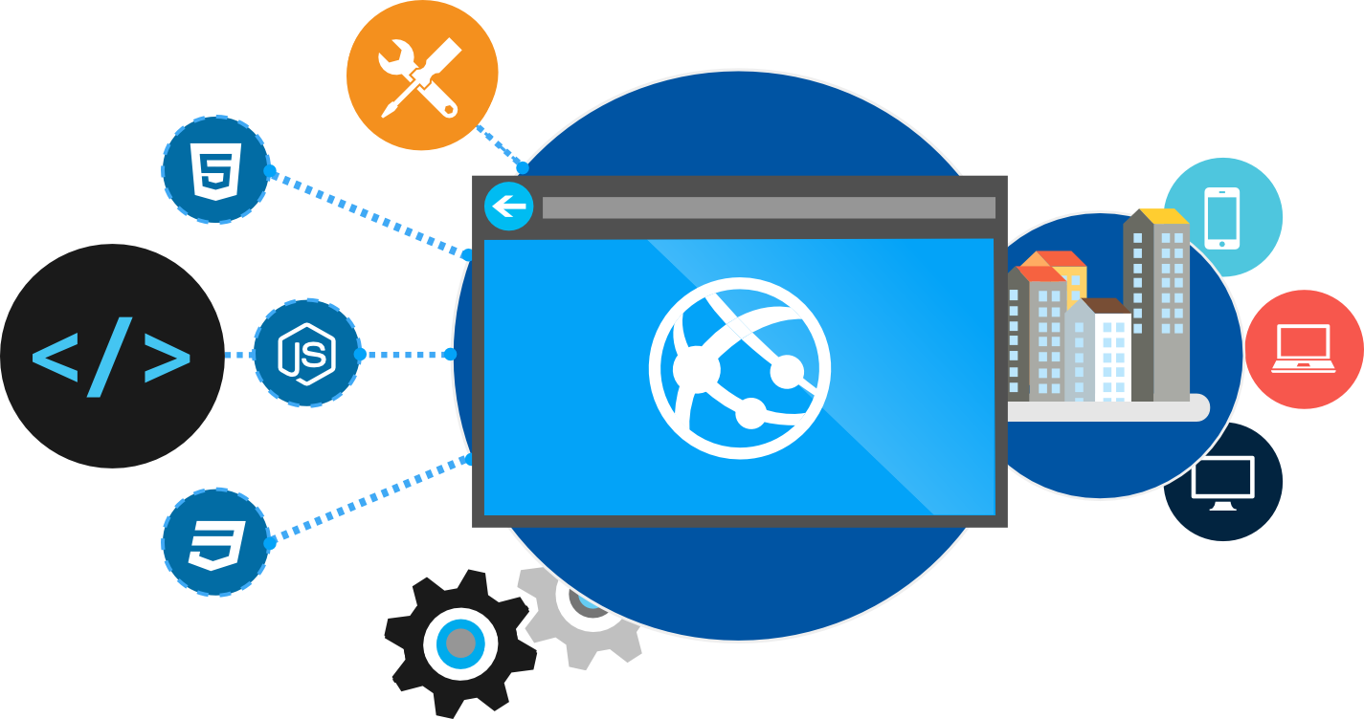
Why do you care?
Browsers have become really powerful
Standards mean you can target features, not browsers
Notes:
So why should you care? Well browsers have become really powerful, and we can use some of these new capabilities to give our websites the edge. And because we are building to standards our content will more or less work anywhere.
Now not all browsers are equal of course, but rather than using code that detects the browser and then serves code for that specific browser, a technique that’s commonly called browser sniffing. We can now use feature detection to determine if a browser supports a specific feature and then either use that feature or if the browser dosen’t support it we can fall back to something more old school. So for example we can use a library like modernizer, or write our own test and determine if a browser supports say HTML5 Video and if it does, we can use that and if it doesn't we can fall back to flash.

Slide 6
Map of Web Browser Standards
HTML
CSS
Web Apps
SVG
Geolocation
ECMA Script 262
Standard
W3C
ECMA
Standards
Body
Notes:
When it comes to web standards there are really two standards bodies that count. We have the W3C and Ecma. W3c look after HTML, CSS, Web Apps, SVG, Geolocation to name but a few and ECMA look after JavaScript.
When you are working with modern standards there are a few websites that can help. So here are a few.

Slide 7
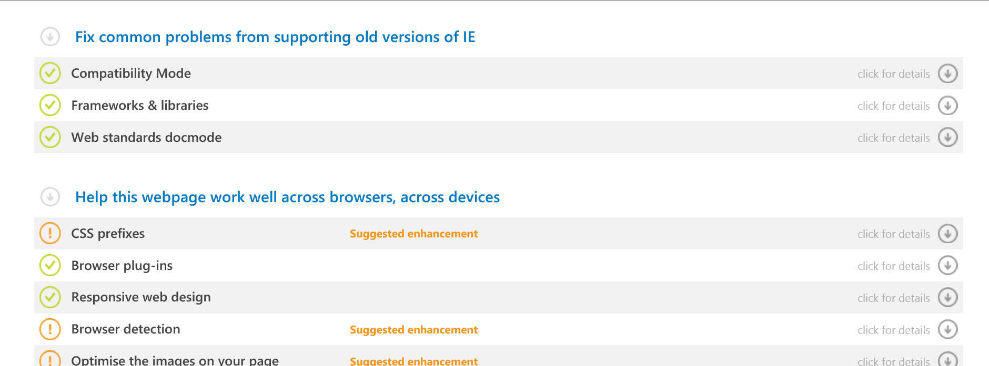
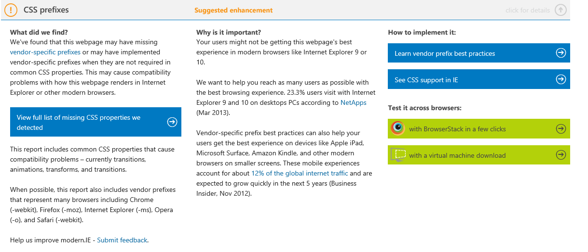
Dev.Modern.IE
http://modern.ie
Notes:
Modern.ie allows to do many things, but one of it’s nice features is it’s site scan tool. You can simply enter a URL and have it produce a report listing all of the things you should consider about your website when making it compatible with modern standards. For example in this report were are told that we are using CSS prefixes >>
And when I click on that it gives me information about the problem the scanner found and intructions on how to fix it.

Slide 8
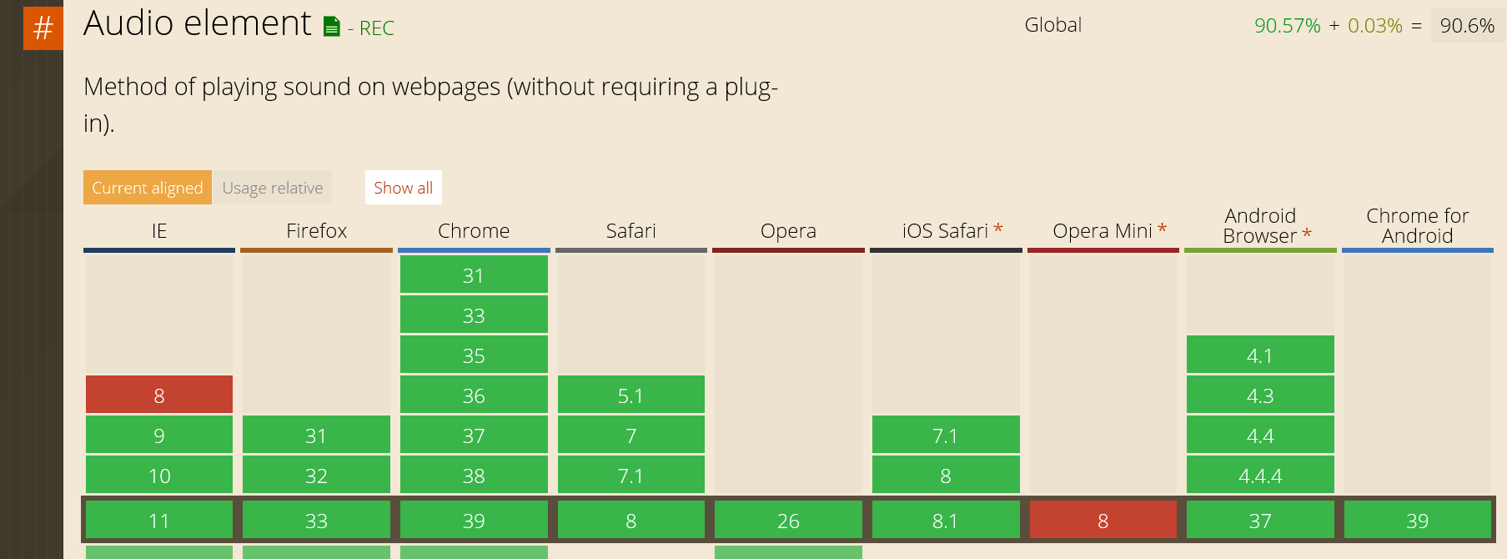
Can I Use
http://caniuse.com
Notes:
Can I use .com allows us to search for specifications and lind browser support for a feature. In this instance it shows us that the Audio element isn’t supported by IE8 but has broad support everywhere else. This information makes it easier to understand if your able to use certain HTML5 features or not as you compare support to the analytics information you have about your users and the browsers that your site needs to support.

Slide 9
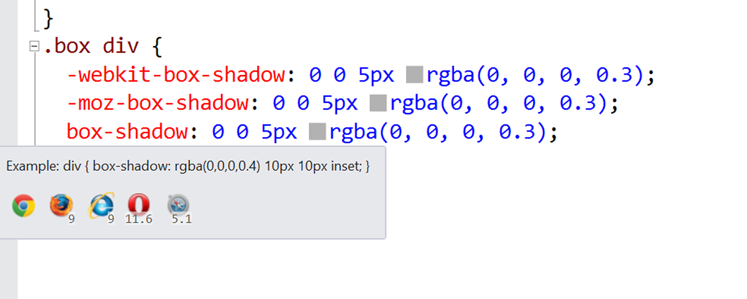
Browser Support
Notes:
It similar in many way to the visual editor provides through web essentials for CSS. As you type a css property intellisence shows the browser support. With box shadow here we can see it’s supported in chrome, firefox 9 and above IE 9 and above and versions of opera and safari.

Slide 10
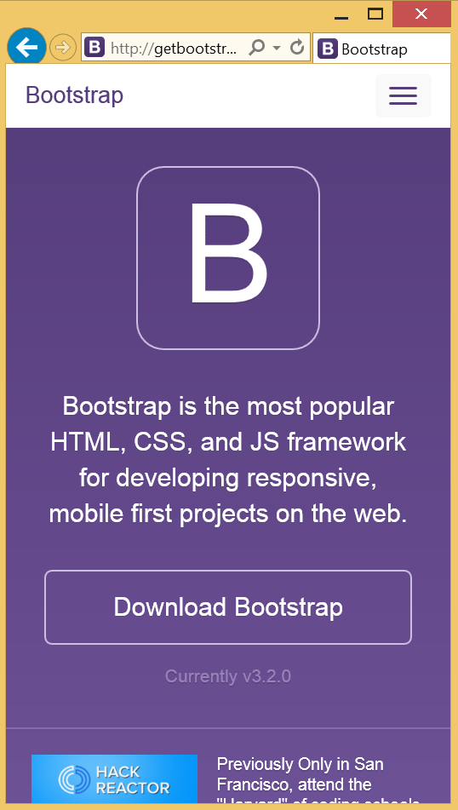
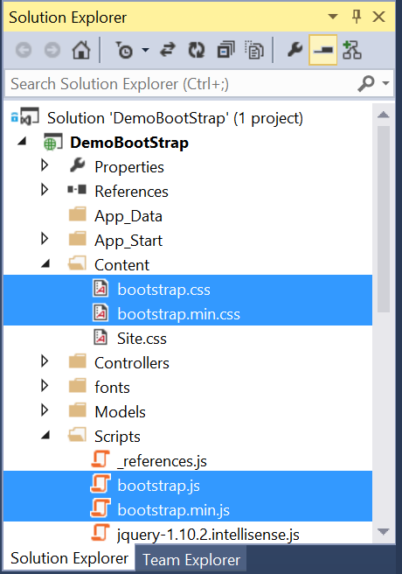
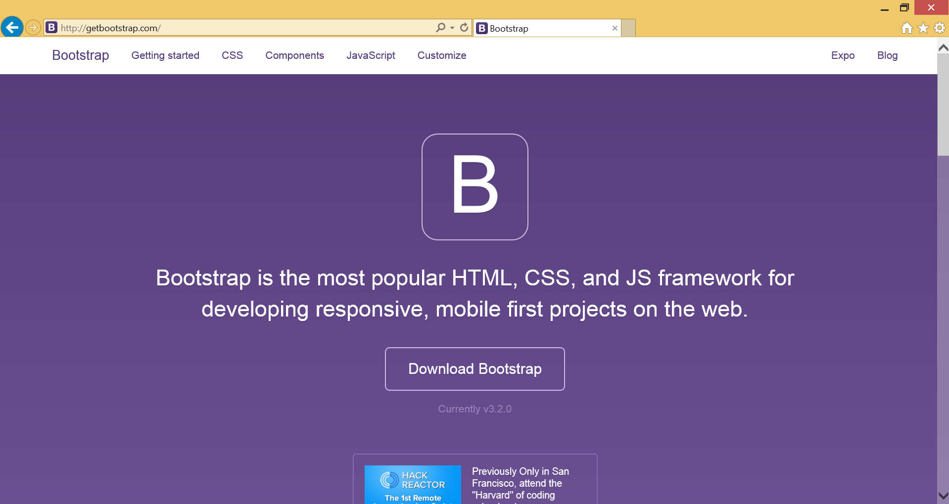
Bootstrap
CSS and JavaScript Library for responsive, mobile first web projects
Added to the base project by NUGET (Currently version 3)
Originally Developed by twitter now open source
Single Responsibility principle applied to CSS
Notes:
Bootstrap is included in all asp.net MVC apps and allows you to easily build responsive sites. Rather than using monolithic unweilding CSS classes. Bootstrap uses small classes that are composed to achieve the desired layout and design effects. This architectural choice of using the Single Responsibility principle, in this way makes Bootstrap very powereful and I’ll explain this inb more detail in a few moments.>>
When you create a new project Nuget adds the files to your project CSS is used and does the bulk of what Bootstrap is famous for. >>
The JS file is used by some of Bootstaps widgets, but this is only required if you use some of those Widgets.

Slide 11
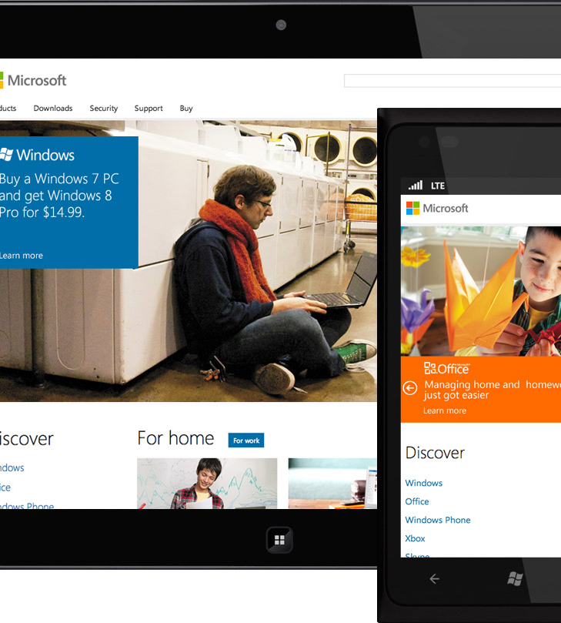
responsive
Mobile
Desktop
Tablet
Notes:
Responsive design and tools like bootstrap make it easier for us web developers to build sites that look great on mobiles >> desktop >> and tablet.

Slide 12
JavaScript Library Overview
Notes:
Next we are going to take a look at some front end JavaScript libraries.

Slide 13
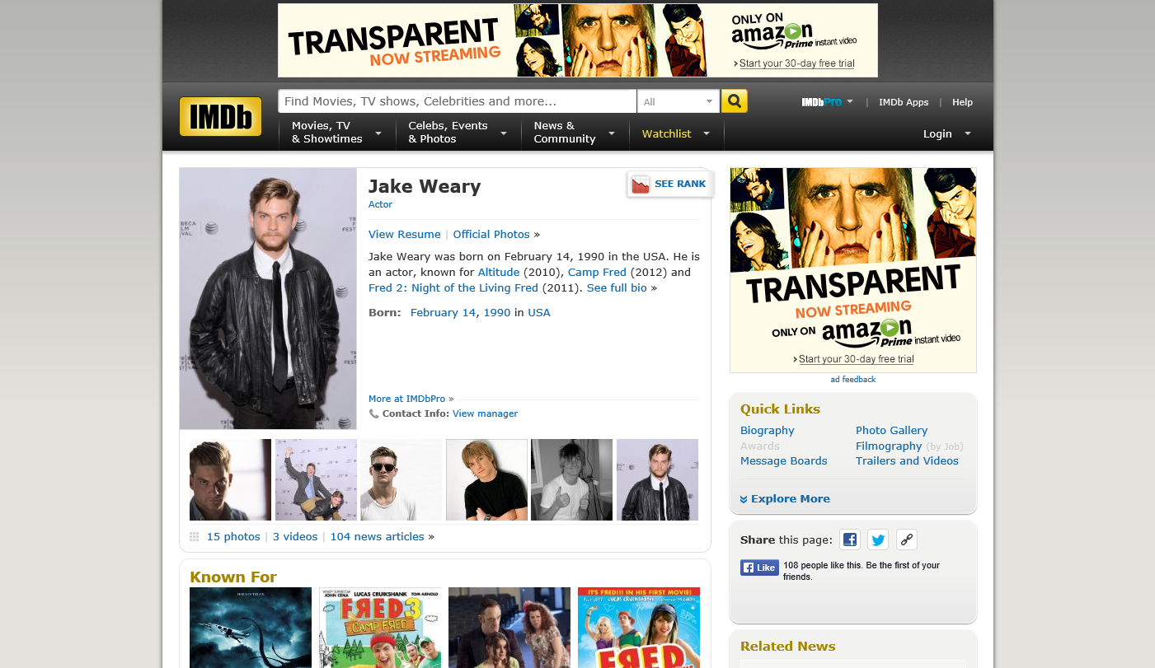
Notes:
This Jake Weary…. Actually this is the actor Jake Weary reather that the JavaScript frame work, but I promise you know that you have heard Jake Weary you will never be able to hear Jquery the same again >>

Slide 14
Who Uses jQuery?
Over 59 million sites
66.2% of the top 10k
http://trends.builtwith.com/javascript/jQuery
Notes:
Lots of people use JQuery. It was one of the first open source frameworks the ASP.net team added to their templates back in the day because of it’s popularity. It’s used by over 59 million sites and 66.2% of the top 10k

Slide 15

jQuery – why so popular?
Easy to learn
Loads of Plugins
Powerful DOM Selection
Lightweight
Community Support
Notes:
It’s so popular because it’s easy to learn, there are loads of plugins, it’s easier to use for element selection and about a million times easier than remembering document.getElementById syntax. It’s small and lightweight, but they key is the community that has built up around it.

Slide 16
Comparison: standard page requests
Client Browser
Request: http://site.com/products/
Web Server
HTML
CSS
Images
Javascript
Response: Full page
Request: http://site.com/products/6
HTML
CSS
Images
Javascript
Response: Full page

Slide 17
Comparison: Single Page Application
Client Browser
Request: http://site.com/products/
Web Server
HTML
CSS
Images
Javascript
Response: Full page
Request: http://site.com/products/6
Product
Response: Tiny bit of data

Slide 18
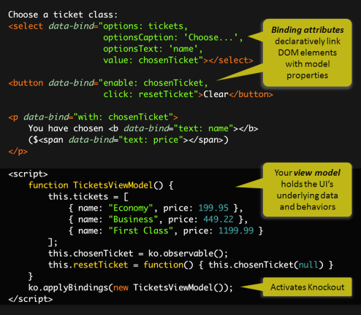
Knockout.js
Declarative Bindings
Automatic UI refresh
Dependency Tracking
Templating
Notes:
Prior to joining Microsoft I worked for a large online retailer, so I know first-hand how difficult it is to produce a good shopping cart. As a user updates quantities, deletes items or changes delivery options it’s important to update the sub total, tax and shipping instructions. It’s critical that the experience reacts quickly and that nothing gets in the way of a user making the purchase.
Even when creating a simple shopping cart it is easy to end up with a bug ridden, mess of JavaScript onChange events. Knockout is a great way of rising to challenges like this it removes all of the complication of creating html that needs to respond to changes in the underlying data source. Knockout.js a JavaScript Library that brings the MVVM pattern to your html applications.
So it’s key features are Declarative Binding – The HTML is attached to the model we create using the html attribute data-bind. This attribute was formally added to the HTML5 specification but will actually work across all browsers, even IE6.
The UI updates automatically, When the model changes all of the bound objects will update automagically. All of the Items that you have bound using the data-bind attribute will change in real time as other elements on the model are changed or recalculated. So when you change the QTY of an item the sub total will be updated.
Knockout also has dependency tracking, It’s easy to set up relationships between different properties on the model. So that the sub total can be a combination of each of the different items multiplied by the QTY.
And lastly use templating so that UI is generated for each item in the shopping cart. The syntax is very much like a for loop. The added benefit is that items that are templated in this way are still able to be automatically refreshed when the model changes.

Slide 19

AngularJS
<!doctype html>
<html ng-app="app">
<body>
<tabs>
<pane title="Localization">
Date: {{ '2013-04-01' | date:'fullDate' }} <br>
Currency: {{ 123456 | currency }} <br>
Number: {{ 98765.4321 | number }} <br>
</pane>
<pane title="Pluralization">
<div ng-controller="BeerCounter">
<div ng-repeat="beerCount in beers">
<ng-pluralize
count="beerCount“
when="beerForms">
</ng-pluralize>
</div>
</div>
</pane>
</tabs>
</body>
</html>
Custom Tag Attributes
Powerful Directives
Declarative Style
Strict Separation
Notes:
AngularJS is an open-source web application framework maintained by Google that’s similar in to Knockout in that it’s a way of developing single page applications where you benefit from things updating automatically and there are separation of concerns but in it’s exectution it’s entirely different. Its goal is to simplify both development and testing of such applications by providing a framework for client-side MVC.
AngularJS directives allow the developer to specify custom and reusable HTML-like elements and attributes that define data bindings and the behavior of presentation components. In the html tag of the application you’ll see that ng-app attribute that Declares the root element of an AngularJS application, under which directives can be used to declare bindings and define behavior.
Again like knockout you are able to set up two way binding so changes are automatically reflected in the UI.
Umbraco a popular ASP.net content management system uses Angular throughout it’s latest realease. Which is notable since they used to use Knockout.

Slide 20
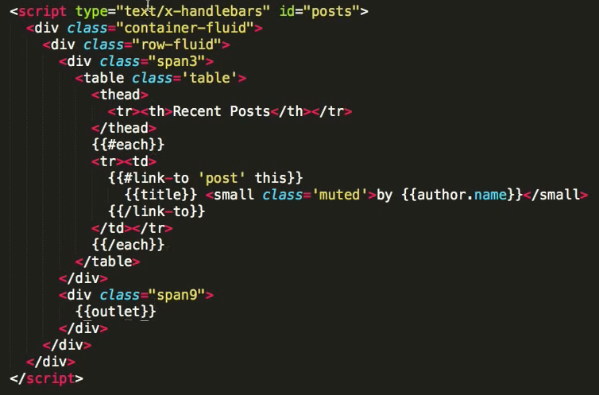

Ember.js
Ember is a framework
Convention over config
URLs are important
Notes:
Ember.js is another JavaScript framework for doing client side MVC, In my opinion it’s slightly easier to integrate ember into an exiting app than something like Angular which is a little more strict about how it is used. We will take a look at an ember demo a little later.

Slide 21
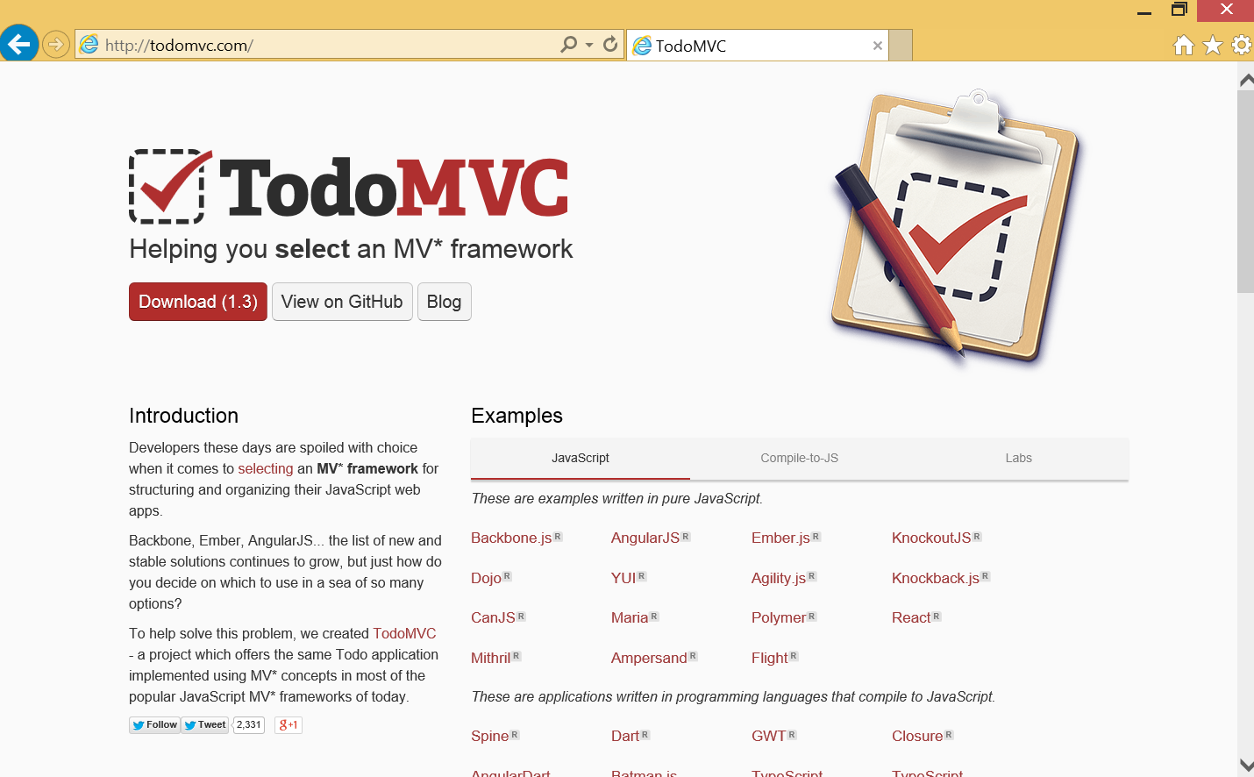
Notes:
Frankly there are a lot of Front end JavaScript frameworks. There is a great project on GitHub called ToDO MVC this project implements the same todo application in multiple MVC, MVVM and MVP client side frameworks. If your thinking about using a frame work you should check out this project because it illustrates in code the various pros and cons of different frameworks.

Slide 22
Ember.js
Notes:
So lets take a look at an ember app in Visual studio

Slide 23
CSS Wizardry
<div class="back correct flip">…</div>
<div class=“front flip">…</div>
<div class="back">…</div>
<div class=“front">…</div>

Slide 24
CSS Animations
https://github.com/thebeebs/geekQuizSPA
/* flip speed */
.flip-container > div {
position: absolute;
-moz-transition: .2s;
-o-transition: .2s;
-webkit-transition: .2s;
transition: .2s;
}
/* hide back of pane during flip */
.front, .back {
-moz-backface-visibility: hidden;
-webkit-backface-visibility: hidden;
backface-visibility: hidden;
}
/* flip transformation */
.flip-container div.front {
-moz-transform: perspective(2000px) rotateY(0deg);
-webkit-transform: perspective(2000px) rotateY(0deg);
-o-transform: perspective(2000px) rotateY(0deg);
transform: perspective(2000px) rotateY(0deg);
}
.flip-container div.front.flip {
-moz-transform: perspective(2000px) rotateY(179.9deg);
-webkit-transform: perspective(2000px) rotateY(179.9deg);
-o-transform: perspective(2000px) rotateY(179.9deg);
transform: perspective(2000px) rotateY(179.9deg);
}
.flip-container div.back {
-moz-transform: perspective(2000px) rotateY(-180deg);
-webkit-transform: perspective(2000px) rotateY(-180deg);
-o-transform: perspective(2000px) rotateY(-180deg);
transform: perspective(2000px) rotateY(-180deg);
}
.flip-container div.back.flip {
-moz-transform: perspective(2000px) rotateY(0deg);
-webkit-transform: perspective(2000px) rotateY(0deg);
-ms-transform: perspective(2000px) rotateY(0);
-o-transform: perspective(2000px) rotateY(0);
transform: perspective(2000px) rotateY(0);
}

Slide 25
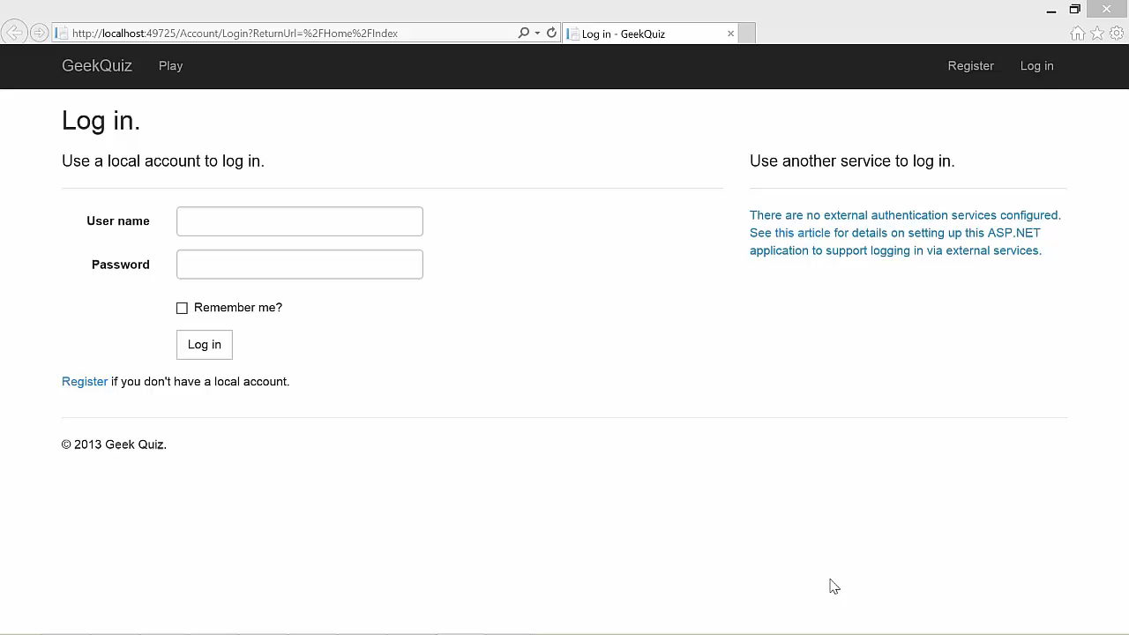

Slide 26
Modern web standards
JavaScript library overview
Building the GeekQuiz front-end

Slide 27
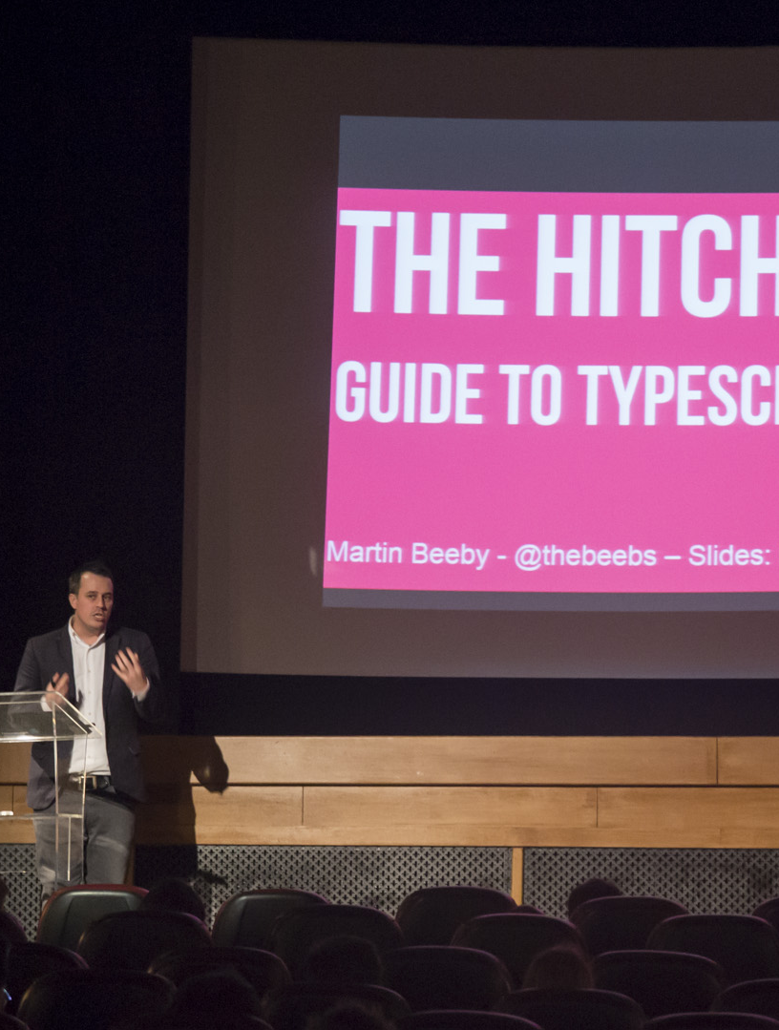
Martin Beeby
martin.beeby@microsoft.com
thebeebs.co.uk
@thebeebs

